Slide 1
Raspberry Pi Smart Home Hub
David Corrigan
Student No:20091014
2020/2021

Slide 2
Smart Home Hub : Objective
The proposed system will sense who is in the room and perform specific actions based on this and some environmental factors.
When there is someone detected in the room and the temperature is over 23 degrees then it would trigger the fan to run until the temperature falls below 22 degrees.
When someone is detected in the room and the time is before 8am or after 5pm then the lamp is automatically turned on, otherwise it’s turned off.
The system will monitor the presence in the room. If a child is present without an adult for 3 minutes then a 5 second video is triggered
A web site will show who is in the room at any point and the current temperature and the last video taken
A Blynk app will show the current temperature the last video taken and also allow the user to trigger a video to be taken ad-hoc.
A tweet will be send to alert the user which will have a link to the last video taken.

Slide 3
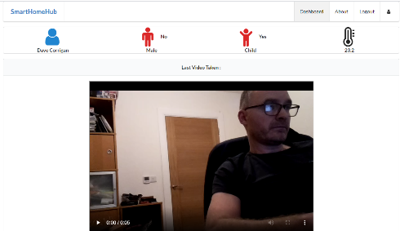

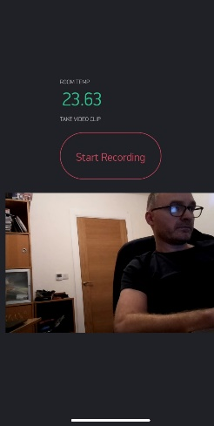
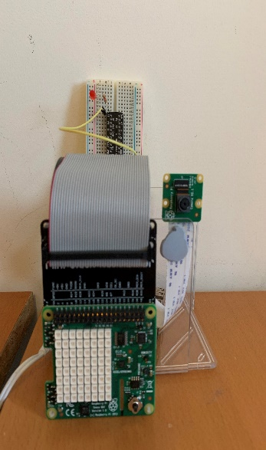





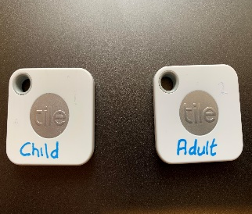

Node.js Website
Overview
Graphic
Video
Video + Data
Blynk
Pi + SenseHat+ Camera
Twitter
API Call to get Data
Temp
Video Record Trigger
API Tweet Request with URL
Data + URL
On/off
Advertising
API Call
BLE Tiles
On/off

Slide 4

Overview of Camera and BLE Tiles Function
Pi + SenseHat+ Camera
The Raspberry Pi is the hub of this Smart Home System. It has a camera, SenseHat and LED attached.
Users of the System will use BLE tiles, one is set up to be recognised as a Child Tile and the other as an Adult tile.
The Pi is programmed as follows:
Scans for Bluetooth devices and recognises the Child and Adult Tile if found.
Determine if the Child and Adult tiles are within the room range using RSSI.
If Child is in room and Adult has not been in room for 3 min, and a video has not been taken for 3 minutes then a 5 second video is taken and stored on Firebase Storage. Entries are also added to the Firebase Realtime Database
The Blynk app can also be used to trigger a video to be taken regardless of who is in the room using the “Start Recording” button in the app.
The last taken video will be available to view on the Blynk app and also on a Node.js website.
Every 30 seconds temperature data, who is present, fan and light triggers and last video URL is send to Thingspeak via HTTP API call
BLE Tiles

Slide 5


Overview of Pi and WiFi Lamp/Fan
The Raspberry Pi will use the SenseHat to monitor the room temperature.
Every 30 seconds it sends information to a Thingspeak Channel.
Temperature
Indicator to turn light on/off
Indicator to turn fan on/off
Indicators of Adult/Child present
The firebase public URL of the video taken.
5 Reacts have been set up in Thingspeak to use this data.
TurnOnLight → ThingHTTP which triggers IFTTT API to turn on light)
TurnOffLight → ThingHTTP which triggers IFTTT API to turn off light)
TurnOnFan → ThingHTTP which triggers IFTTT API to turn on fan)
TurnOffFan → ThingHTTP which triggers IFTTT API to turn off fan)
VideoTakenTweet → ThingTweet send a tweet with the URL of Video

Slide 6
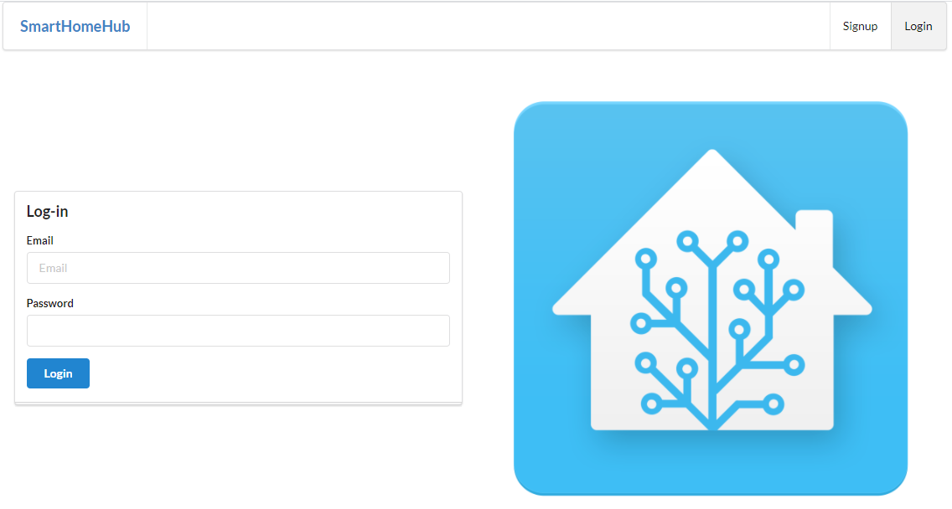
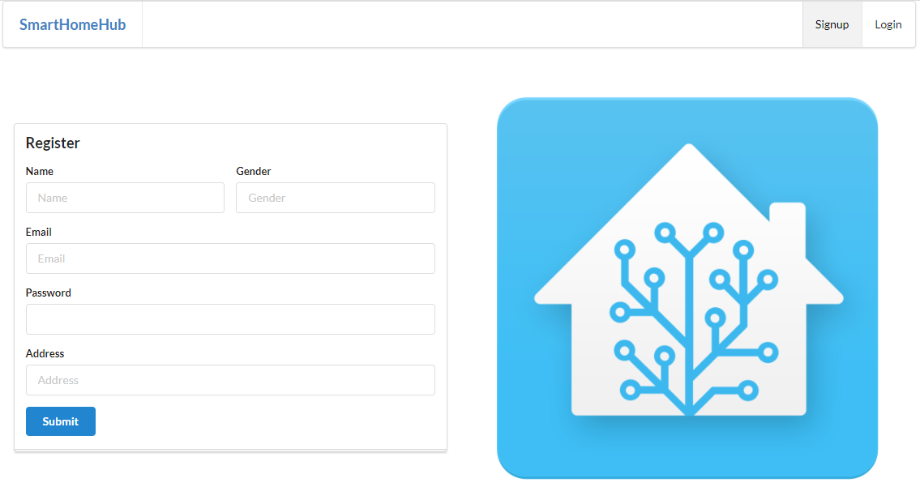
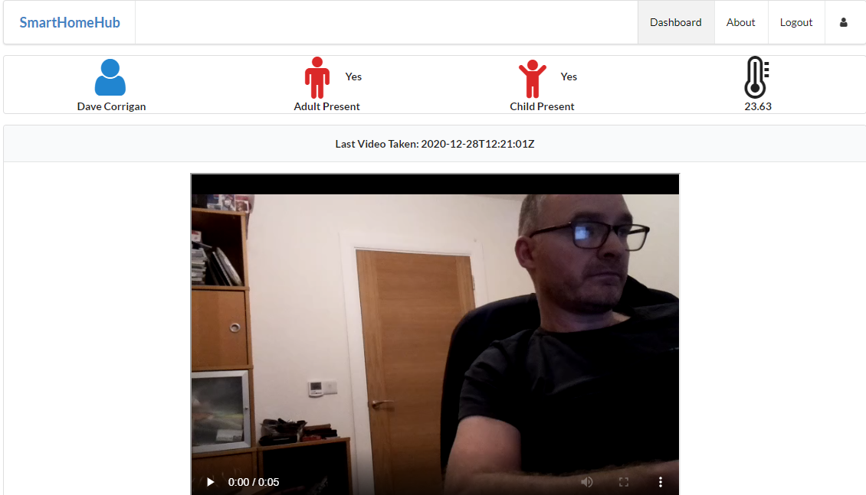
Overview of Website
A website built in Node.js and using JavaScript and JSON. It uses the handlebars template engine.
Functionality has been built to allow a user to register for the website and only then a user can log-in.
Only authenticated users can login and view the last video taken and the dashboard data.
JSON files are used to store the user information

Slide 7
Website Continued
Data for the Dashboard is retrieved from Thingspeak using a API call resulting in data in a JSON object. This data is passed down to the handlebars view from the Dashboard controller. This data includes:
Indicator if Adult is present in room
Indicator if Child is present in room
The current room temperature
The URL of the Firebase storage video

Slide 8
Blynk App Functionality
A Blynk app has been built which will both take information from the Pi Smart Hub and also send instructions to the Smart Hub
The current room temperature is sent to the Blynk app every 5 seconds. I did try to send the info of who was in the room, but there seems to be a known issue with IOS where only one feed from the Pi works at a time to Blynk.
There is a button on the Blynk app ‘Start Recording’ which when pressed will send an instruction to the Smart Hub to trigger a 5 second video to be taken. This video is taken regardless of the presence in the room of adult or child.
Finally the last video taken will be displayed in the Blynk application.

Slide 9
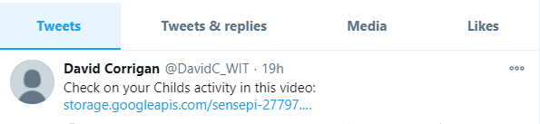
Additional Information
New videos will trigger a tweet like this to be sent which will include
The ULR of the latest video taken:
Link to the Glitch Node.js website:
https://smart-home-hub.glitch.me/
Logon Details:
Email: frankwalsh@gmail.com
Password: password

Slide 10
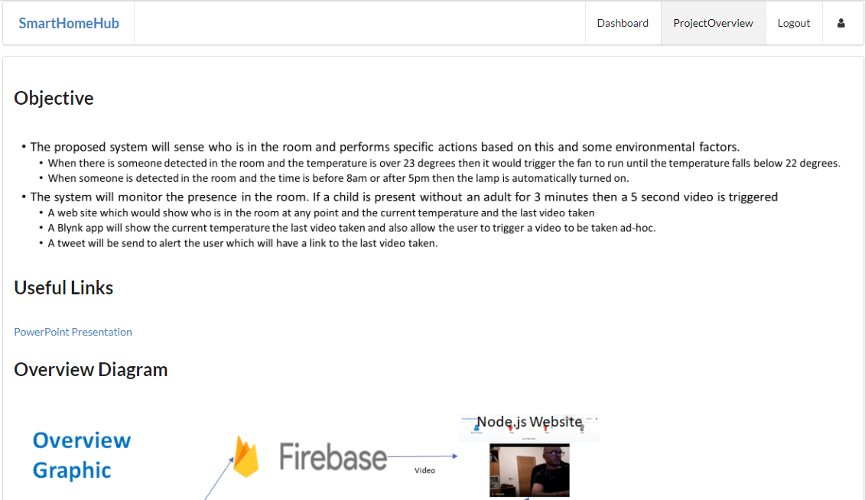
Information Tab on Website
A Project Overview tab gives the high level objectives of the project
It also has a link to the PowerPoint presentation about the project.
And finally has an overview diagram of how the smart home hub system is set up

Slide 11
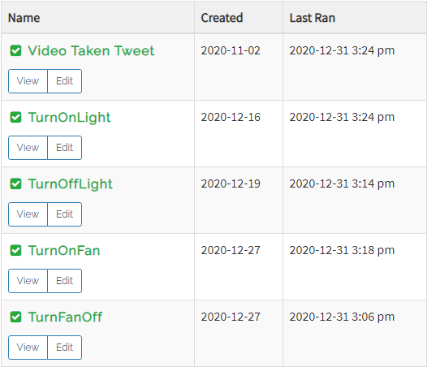
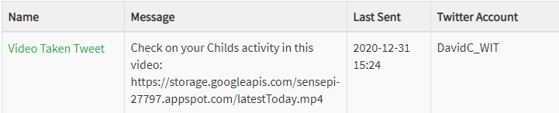
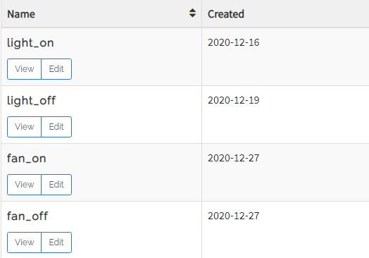
Appendix A: Thingspeak Reacts ThingHTTP/ThingTweet

